Slide 1
CSD3009 - Data Structures and Analysis of Algorithms
Dr. SIVABALAN KR

Slide 2
What is Data.?
Data refers to raw and unprocessed information that is collected, stored, and used for various purposes.
It can be in the form of numbers, text, images, audio, video, and more.
Data is the foundation of information, knowledge, and insights.
It plays a crucial role in decision-making, analysis, and understanding various phenomena.

Slide 3
What is Data.?
Data can be collected from various sources, including sensors, surveys, transactions, social media, and more.
In this digital age, the amount of data being generated and collected has grown exponentially.
This has led to the field of "big data," which deals with the challenges of storing, processing, and analyzing massive volumes of data to derive valuable insights and knowledge.

Slide 4
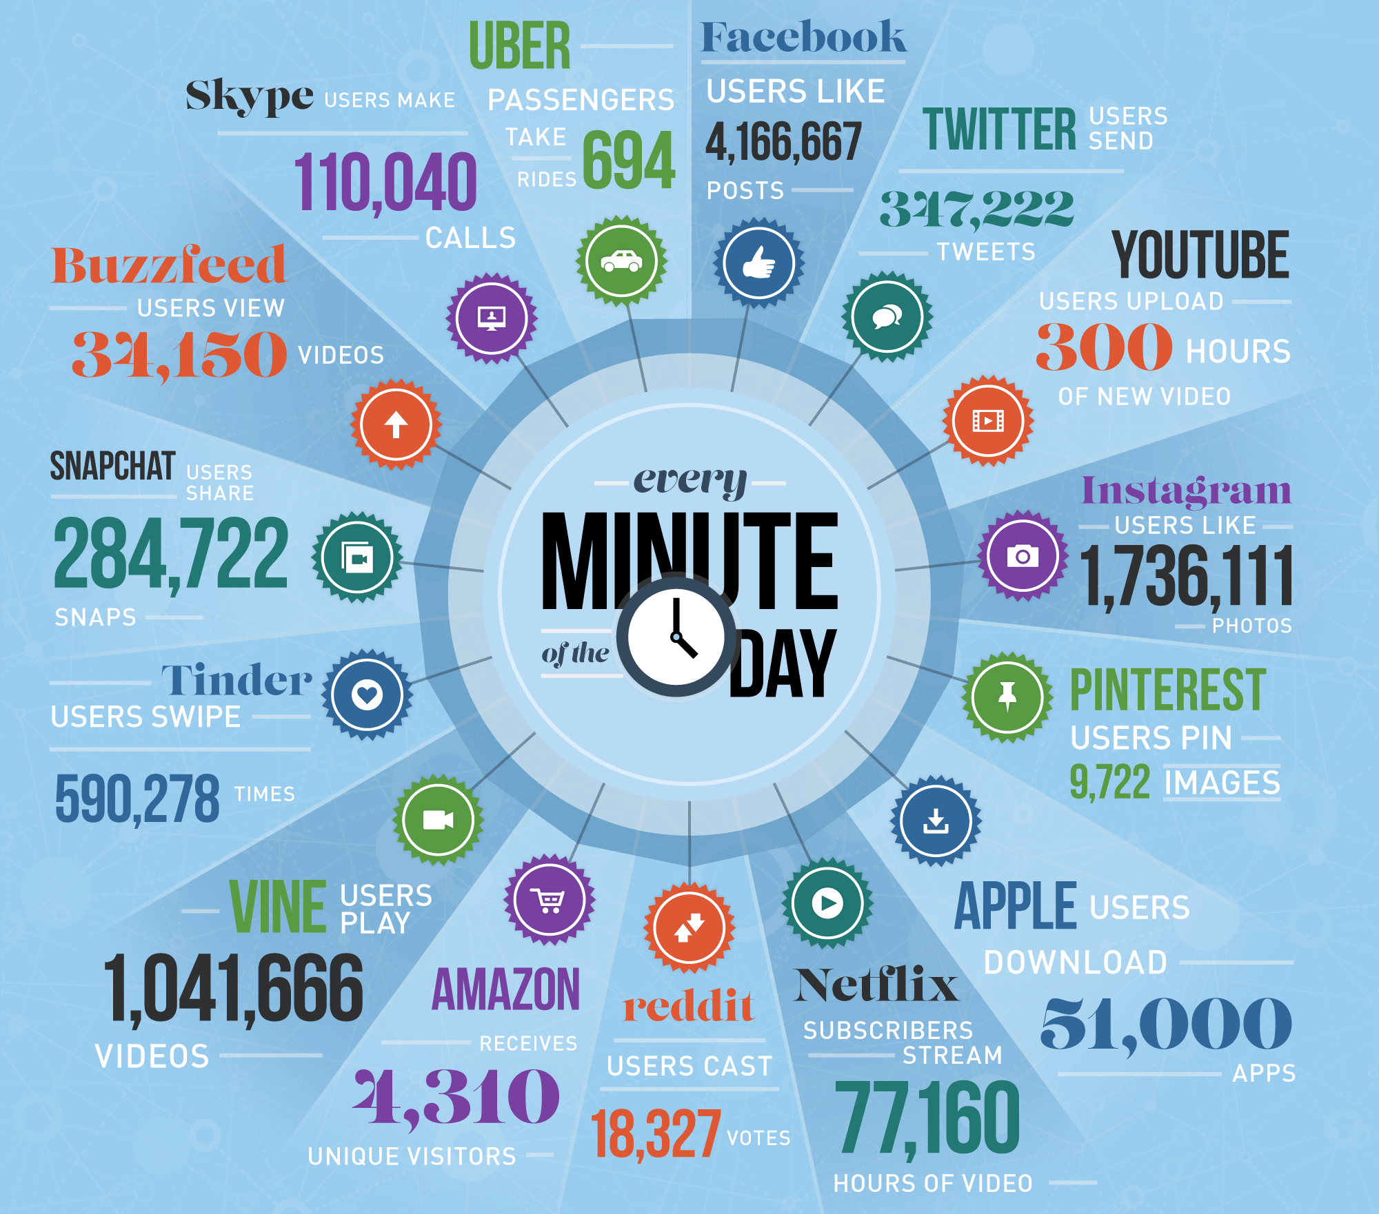
Data Growth
Figure 1: Data growth

Slide 5
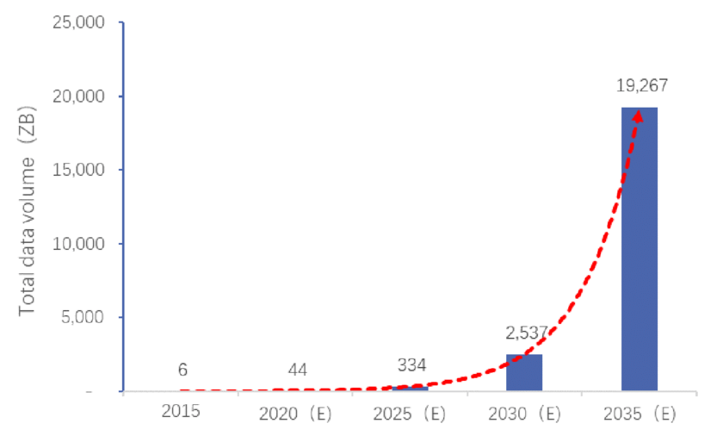
Data Growth
Figure 2: Data growth

Slide 6
Two main types of data
Structured Data:
This type of data is organized and follows a specific format or structure.
It is typically found in databases, spreadsheets, and tables.
Structured data is easy to search, sort, and analyze using various tools and techniques.
Unstructured Data:
Unstructured data doesn't have a predefined format and can include text, images, audio, and video.
This type of data is more challenging to analyze and process compared to structured data, but it often holds valuable insights and information.

Slide 7
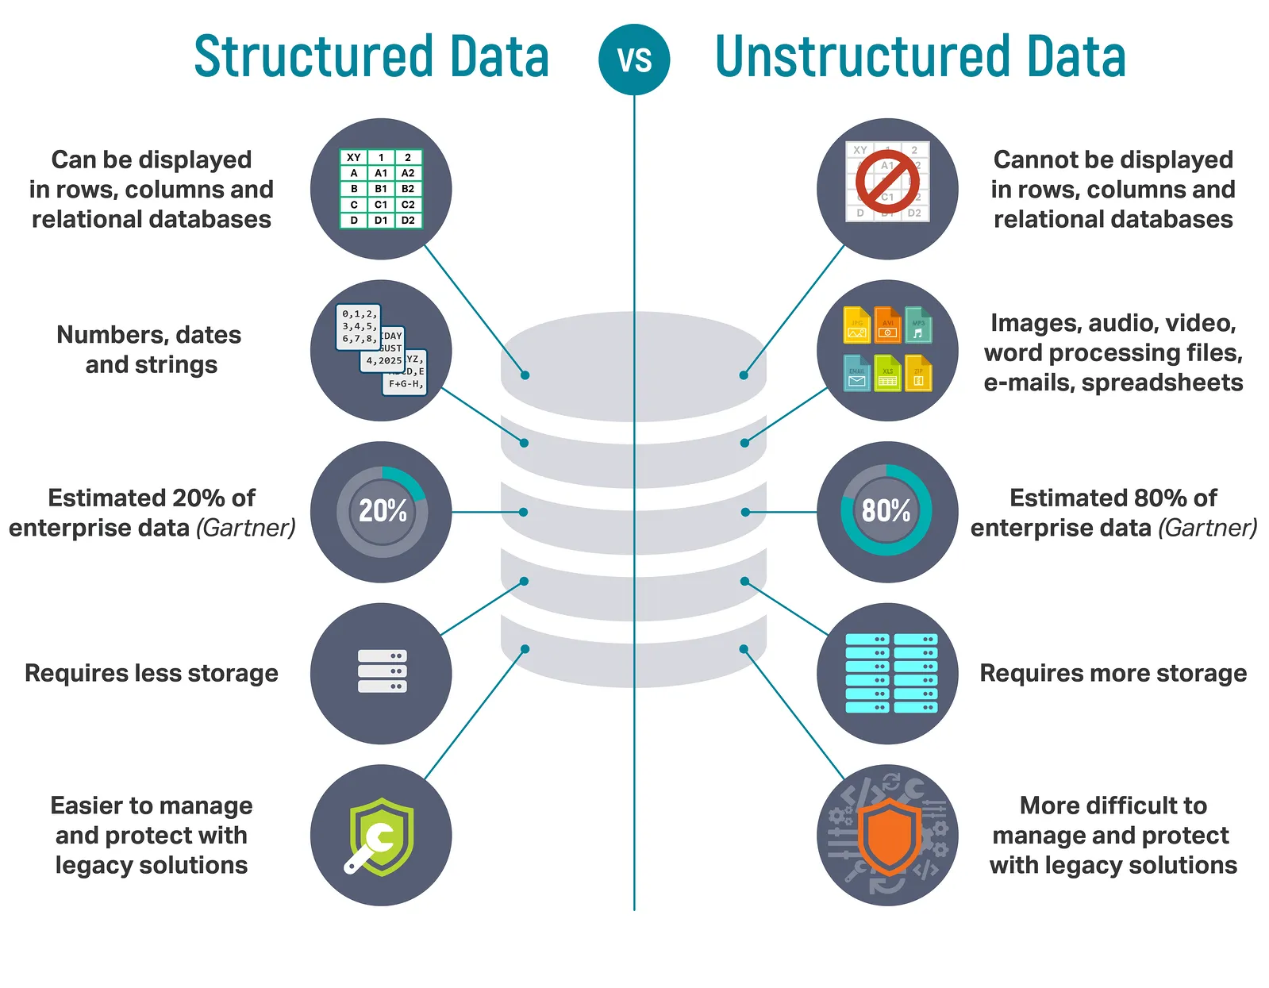
Two main types of data
Figure 3: Structured vs Unstructured Data

Slide 8
What is Data Structures
A data structure is a way of organizing and storing data in a computer's memory or storage system so that it can be efficiently accessed, manipulated, and managed.
Data structure is representation of the logical relationship existing between individual elements of data.
It provides a framework for organizing and structuring data elements, such as numbers, characters, or other pieces of information, in a logical and coherent manner.
Data structures are essential for programming because they determine how data is stored and how operations can be performed on that data.

Slide 9
Classification of Data Structures
Primitive Data Structure (Predefined Size)
Non-Primitive Data Structure (User defined size)
Data structure
Primitive DS
Non-Primitive DS
Integer
Float
Character
Pointer
Integer
Float
Float
Figure 4: Classification of Data Structure

Slide 10
Classification of Data Structures
Non-Primitive DS
Linear List
Non-Linear List
Array
Queue
Graph
Trees
Link List
Stack
Figure 5: Non Primitive Data Structure

Slide 11
A Philosophy of Data Structures
The philosophy of data structures refers to the underlying principles and concepts that guide the design, organization, and manipulation of data.
It involves to make decisions about how data should be stored, accessed, and manipulated to optimize various operations and achieve desired outcomes efficiently.

Slide 12
Key principles
Efficiency: Data structures are designed to optimize specific operations, such as insertion, deletion, and retrieval of data. The choice of a data structure can significantly impact the efficiency of these operations.
Trade-offs: Different data structures excel in different scenarios, and there are often trade-offs between factors such as memory usage, processing speed, and ease of implementation.
Algorithm Design: The philosophy of data structures is closely related with algorithm design. Effective algorithms often depend on the choice of data structures to efficiently solve specific problems.

Slide 13
Key principles
Modularity and Reusability: Well-designed data structures are modular and can be reused in various contexts.
Data Integrity: Data structures should maintain consistency and accuracy, even when undergoing various data.
Flexibility: Data structures should be adaptable to accommodate evolving needs without requiring significant reengineering.
Analysis: Analyzing the time complexity and space complexity of various data structures and algorithms. This analysis helps in selecting the most appropriate option for a given application.

Slide 14
The Need for Data Structures
Efficient Data Organization: Well-designed data structures can minimize memory usage and enable fast access and manipulation of data, leading to optimized program performance.
Effective Data Manipulation: Arrays are great for random access, linked lists are efficient for insertions and deletions, and hash tables are suitable for fast key-based lookups.
Optimized Algorithms: Many algorithms and processes are built upon specific data structures. For example, sorting algorithms often rely on arrays or linked lists, and graph algorithms are built around graph data structures.

Slide 15
The Need for Data Structures
Problem Solving: Many real-world problems can be abstracted and solved using data structures. By employing the right data structures, programmers can model and tackle complex problems more effectively.
Code Reusability: Well-designed data structures can be reused in various projects and applications.
Scalability: As data sizes increase, the performance of an application can degrade if inappropriate data structures are used.
Ease of Maintenance: Data structures are well-suited to the problem domain, it's easier for developers to understand and maintain the codebase.
Cross-Disciplinary Applications: Data structures are not limited to programming but have applications in various fields, such as databases, networking, artificial intelligence, and more. A solid understanding of data structures can be beneficial in multiple domains.

Slide 16
Cost and Benefits
Cost factors
Development Complexity: Designing and implementing data structures can be complex and time-consuming.
Resource Consumption: Some data structures consume more memory or processing power than others. Choosing the wrong data structure can lead to resource wastage and decreased performance.
Trade-offs: Selecting the right data structure involves understanding trade-offs between different factors such as time complexity, memory usage, and ease of implementation. These trade-offs can be complex and require careful consideration.
Algorithm Complexity: Not all algorithms work optimally with all data structures. The choice of data structure can impact the complexity and efficiency of the algorithms used.

Slide 17
Benefits
On the basis of | Structured data | Unstructured data
Technology | It is based on a relational database. | It is based on character and binary data.
Robustness | It is very robust. | It is less robust.
Performance | Here, we can perform a structured query that allows complex joining, so the performance is higher. | Textual queries are possible. So, the performance is lower than structured data.
Format | It has a predefined format. | It has a variety of formats, i.e., it comes in a variety of shapes and sizes.
Analysis | It is easy to search. | Searching for unstructured data is more difficult.

Slide 18
Abstract Data Type
Abstract Data type (ADT) is a type for objects whose behavior is defined by a set of values and a set of operations.
The definition of ADT only mentions what operations are to be performed but not how these operations will be implemented.
Interface
Program
Data Structure
Add
Request
Remove
Find
Result
Display
Figure 6: Abstract Data Type

Slide 19
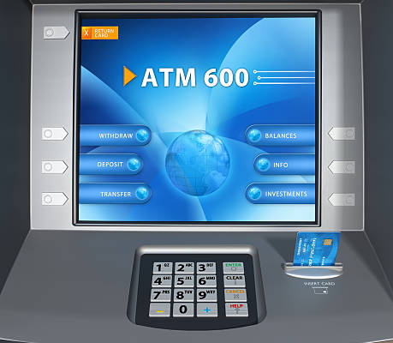

Abstract Data Type
It does not specify how data will be organized in memory and what algorithms will be used for implementing the operations.
Figure 7: Abstract Data Type Examples

Slide 20
Abstract Data Type Advantages
Encapsulation: ADTs provide a way to encapsulate data and operations into a single unit, making it easier to manage and modify the data structure.
Abstraction: ADTs allow users to work with data structures without having to know the implementation details, which can simplify programming and reduce errors.
Data Structure Independence: ADTs can be implemented using different data structures, which can make it easier to adapt to changing needs and requirements.
Information Hiding: ADTs can protect the integrity of data by controlling access and preventing unauthorized modifications.

Slide 21
Abstract Data Type Disadvantages
Overhead: Implementing ADTs can add overhead in terms of memory and processing, which can affect performance.
Complexity: ADTs can be complex to implement, especially for large and complex data structures.
Learning Curve: Using ADTs requires knowledge of their implementation and usage, which can take time and effort to learn.
Limited Flexibility: Some ADTs may be limited in their functionality or may not be suitable for all types of data structures.
Cost: Implementing ADTs may require additional resources and investment, which can increase the cost of development.

Slide 22
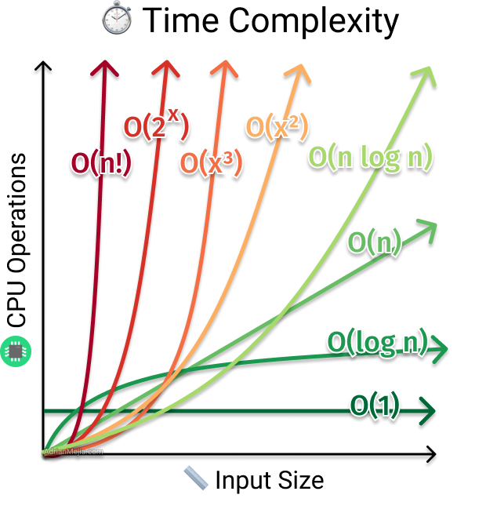
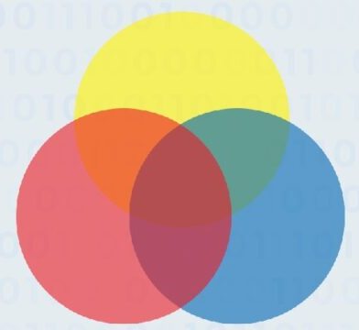
Complexity Analysis
Complexity analysis is defined as a technique to characterize the time taken by an algorithm with respect to input size (independent from the machine, language and compiler).
Types of Complexity Analysis
Time Complexity
Space Complexity
Figure 8: Space Complexity
Figure 9: Time Complexity

Slide 23
Need for Complexity Analysis
Complexity Analysis determines the amount of time and space resources required to execute it.
It is used for comparing different algorithms on different input sizes.
Complexity helps to determine the difficulty of a problem.
often measured by how much time and space (memory) it takes to solve a particular problem

Slide 24
Time Complexity Analysis
Worst Case Analysis: (Big 0)
Most of the time, we do worst-case analyses to analyze algorithms. In the worst analysis, we guarantee an upper bound on the running time of an algorithm which is good information.
Average Case Analysis (Theta Notation)
The average case analysis is not easy to do in most practical cases and it is rarely done. In the average case analysis, we must know (or predict) the mathematical distribution of all possible inputs.
Best Case Analysis (Omega Notation)
The Best Case analysis is bogus. Guaranteeing a lower bound on an algorithm doesn’t provide any information as in the worst case, an algorithm may take years to run.

Slide 25
Worst Case Analysis:
Big O Notation is a tool used to describe the time complexity of algorithms.
It calculates the time taken to run an algorithm as the input grows.
In other words, it calculates the worst-case time complexity of an algorithm.
Big O Notation in Data Structure describes the upper bound of an algorithm's runtime.
Figure 10: Time Complexity (Worst Case Analysis)

Slide 26
Array
Data types examined so far are atomic:
int, long
float, double
char
Called “simple” data types because it holds a single value
If limited to “simple” data types, many programming applications are tedious
Solution: use structured data types - types that represent more than one piece of data

Slide 27
Array Data Structure
A Data Structure is a grouping of data items in memory under one name
When data items same type, can use Array
Using an array, we can set aside a block of memory giving the block a name:
Sales vs. S0
S1
…
S9

Slide 28
Parts of an Array

Slide 29
Declaring a 1D Array
Syntax: Type Name[Integer]
Type can be any type we have used so far
Name is a variable name used for the whole array
Integer literal in between the square brackets ([]) gives the size of the array (number of sub-parts)
Size must be a constant value (no variable size)
Parts of the array are numbered starting from 0
1-Dimensional (1D) because it has one index
Example:
float Sales[10];
/* float array with 10 parts numbered 0 to 9 */

Slide 30
Accessing Array Elements
Requires
array name,
subscript labeling individual element
Syntax: name[subscript]
Example
Sales[5] refers to the sales totals for employee 5
Sales[5] can be treated like any float variable:
Sales[5] = 123.45;
printf(“Sales for employee 5: $%7.2f\n”,Sales[5]);

Slide 31
Invalid Array Usage
Example:
float Sales[10];
Invalid array assignments:
Sales = 17.50; /* missing subscript */
Sales[-1] = 17.50; /* subscript out of range */
Sales[10] = 17.50; /* subscript out of range */
Sales[7.0] = 17.50; /* subscript wrong type */
Sales[‘a’] = 17.50; /* subscript wrong type */
Sales[7] = ‘A’; /* data is wrong type */
Conversion will still occur:
Sales[7] = 17; /* 17 converted to float */

Slide 32
Array Initialization
Arrays may be initialized, but we need to give a list of values
Syntax:
Type Name[Size] =
{ value0, value1, value2, …, valueSize-1 };
value0 initializes Name[0], value1 initializes Name[1], etc.
values must be of appropriate type (though automatic casting will occur)

Slide 33
Array Initialization
Example:
int NumDays[12] = { 31, 28, 31, 30, 31, 30, 31, 31, 30, 31, 30, 31 }; /* Jan is 0, Feb is 1, etc. */
int NumDays[13] = { 0, 31, 28, 31, 30, 31, 30, 31, 31, 30, 31, 30, 31 }; /* Jan is 1, Feb is 2, */
Note:
if too few values provided, remaining array members not initialized
if too many values provided, a syntax error or warning may occur (extra values ignored)

Slide 34
Towards Dynamic Data Structures
Array is a collection of homogeneous elements which are stored at consecutive locations
Main limitations of arrays:
It is a static data structure
Its size must be known at compilation time, in most programming languages
Inefficient insertion and deletion of elements
A dynamic data structure can overcome these problems

Slide 35
What is a Linked List?
A linked list is a collection of nodes, each node holding some information and a pointer to another node in the list
In the following example, there are four nodes, which are not stored at consecutive locations
300
100
400
40
!
80
25
600
30
Information part
Pointer (Address part)

Slide 36
Advantages of linked list
Unused locations in array is often a wastage of space
Linked lists offer an efficient use of memory
Create nodes when they are required
Delete nodes when they are not required anymore
We don’t have to know in advance how long the list should be

Slide 37
Singly Linked Lists
A singly linked list is a concrete data structure consisting of a sequence of nodes.
Each node stores
element
link to the next node
next
elem
node
∅
A
B
C
D

Slide 38
Singly Linked Lists
A node reference another node, the next reference inside a node is a link or pointer to another node.
Moving from one node to another by following a next reference is known as link hopping or pointer hopping.
The first and last node of a linked list usually are called the head and tail of the list, respectively.
Thus, we can link hop through the list starting at the head and ending at the tail.
We can identify the tail as the node having a null next reference, which indicates the end of the list.
A linked list defined in this way is known as a singly linked list.

Slide 39
Singly Linked Lists
Like an array,
a singly linked list keeps its elements in a certain order.
This order is determined by the chain of next links going from each node to its successor in the list.
Unlike an array,
a singly linked list does not have a predetermined fixed size,
and uses space proportional to the number of its elements.
Likewise, we do not keep track of any index numbers for the nodes in a linked list.
So we cannot tell just by examining a node if it is the second, fifth, or twentieth node in the list.

Slide 40
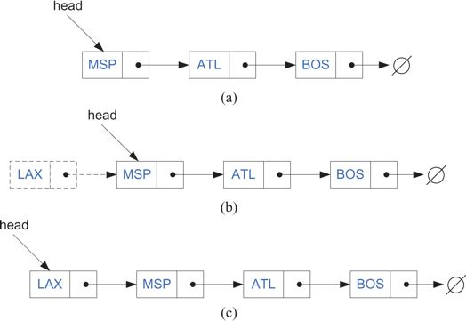
Insertion in a Singly Linked List
When using a singly linked list, we can easily insert an element at the head of the list.
The main idea is:
create a new node,
set its next link to refer to the same object as head,
and then set head to point to the new node.

Slide 41
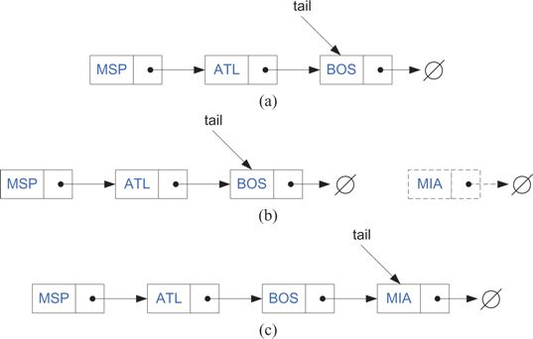
Inserting an Element at the Tail of a Singly Linked List
We can also easily insert an element at the tail of the list, provided we keep a reference to the tail node.
In this case,
we create a new node,
assign its next reference to point to the null object,
set the next reference of the tail to point to this new object,
and then assign the tail reference itself to this new node.

Slide 42
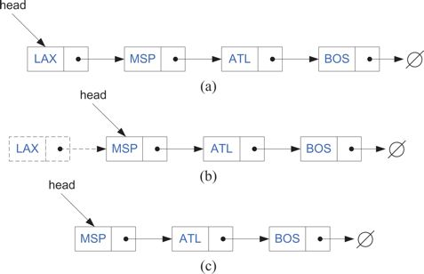
Removing an Element in a Singly Linked List
The reverse operation of inserting a new element at the head of a linked list is to remove an element at the head.
Figure: Removal of an element at the head of a singly linked list:
(a) before the removal;
(b) "linking out" the old new node;
(c) after the removal.

Slide 43
Removing an Tail Element
Unfortunately, we cannot easily delete the tail node of a singly linked list. Even if we have a tail reference directly to the last node of the list,
we must be able to access the node before the last node in order to remove the last node.
But we cannot reach the node before the tail by following next links from the tail.
The only way to access this node is to start from the head of the list and search all the way through the list.
But such a sequence of link hopping operations could take a long time.

Slide 44

Doubly Linked Lists
There is a type of linked list that allows us to go in both directions
—forward
and reverse—in a linked list.
It is the doubly linked list.
Such lists allow for
a great variety of quick update operations, including insertion and removal at both ends, and in the middle.
A node in a doubly linked list stores two references
—a next link, which points to the next node in the list,
and a prev link, which points to the previous node in the list.

Slide 45
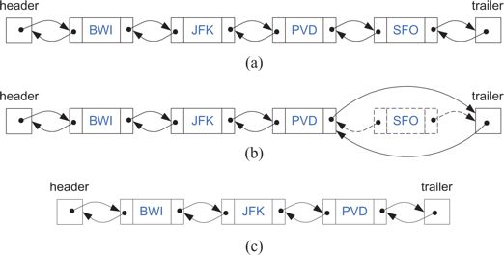
Doubly Linked Lists
Inserting or removing elements at either end of a doubly linked list is straight- forward to do.
Indeed, the prev links eliminate the need to traverse the list to get to the node just before the tail.
Figure :Removing the node at the end of a a doubly linked list with header and trailer sentinels: (a) before deleting at the tail; (b) deleting at the tail; (c) after the deletion.

Slide 46
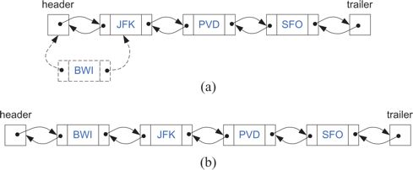
Adding an element in Doubly Linked Lists
Likewise, we can easily perform an insertion of a new element at the beginning of a doubly linked list.
Figure: Adding an element at the front: (a) during; (b) after.

Slide 47
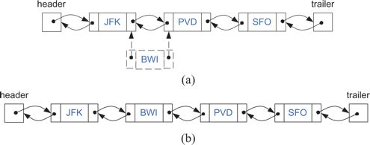
Insertion in the Middle of a Doubly Linked List
Figure : Adding a new node after the node storing JFK: (a) creating a new node with element BWI and linking it in; (b) after the insertion.

Slide 48
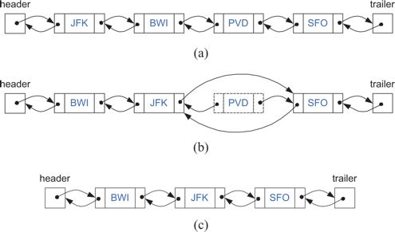
Removal in the Middle of a Doubly Linked List
Figure : Removing the node storing PVD: (a) before the removal; (b) linking out the old node;
(c) after the removal (and garbage collection).

Slide 49
Circularly Linked Lists
A circularly linked list has the same kind of nodes as a singly linked list.
Each node in a circularly linked list has a next pointer and a reference to an element.
But there is no head or tail in a circularly linked list.
For instead of having the last node's next pointer be null,
in a circularly linked list, it points back to the first node.
Thus, there is no first or last node.
If we traverse the nodes of a circularly linked list from any node by following next pointers, we will cycle through the nodes.
Even though a circularly linked list has no beginning or end,
but we need some node to be marked as a special node, which we call the cursor.
The cursor node allows us to have a place to start from if we ever need to traverse a circularly linked list.
And if we remember this starting point, then we can also know when we are done-we are done with a traversal of a circularly linked list when we return to the node that was the cursor node when we started.

Slide 50
Recursion
A recursive function is a function that calls itself in order to solve a problem or perform a task.
In a recursive function, the problem is divided into smaller subproblems of the same type, and each of these subproblems is solved by calling the function recursively until a base case is reached.
The base case is a condition where the function stops calling itself and returns a result. Recursive functions are commonly used in programming and mathematics to solve problems that can be broken down into smaller, similar problems.
Example (Factorial Value)
n! = n * (n – 1)!
n! = 1 if n = 0 or n = 1

Slide 51
Recursion
Linear recursion
Linear recursion is a specific type of recursion where a recursive function calls itself exactly once in each recursive step
Binary recursion
In binary recursion, the function calls itself twice in each run. As a result, the calculation depends on two results from two different recursive calls.
Multiple recursions
multiple recursion is the activation of a method can cause more than one recursive activations of the same method.

